Slide 1
SPM ONLINE REVIEW
G1T8 - LET'S GIT IT
HILYA SYAZWANI
LIM HUI SIN
LIM JIE MIN
TAN XIN RONG STEFFI
KU SEOUNGLIM (SKY)

Slide 2

OVERVIEW
WEEK 7 VS WEEK 9
SCHEDULE
BIRD’S EYE VIEW
WORK DIVISION
BUFFER TIME
CRITICAL PATH ANALYSIS
BUG METRICS
BUG METRICS (ITERATION 1)
BUG METRICS (ITERATION 2)
ROLES & RESPONSIBILITIES
ROLE ALLOCATIONS
PP AND PM ROTATIONS

Slide 3
WEEK 7 VS WEEK 9
Comparison
WEEK 7:
Completed functionalities
Login page (Student + Admin)
View Bidding Summary Table
Pair rotations
Fixed PP partners
WEEK 9:
Completed functionalities
Bootstrap
Add Bid
Drop Bid
Open / close round
Pair rotations
Rotating PP partners – Due to conflicting schedules
Notes:
Functionalities
Do you plan to drop/add any functionalities?
Do you plan to use any PHP frameworks?
Did you manage to finish login + 1 functionality? (**NEW**)
What functionalities have you finished? (**NEW**)
What is the IP address & admin password for your cloud deployment? (**NEW**)

Slide 4
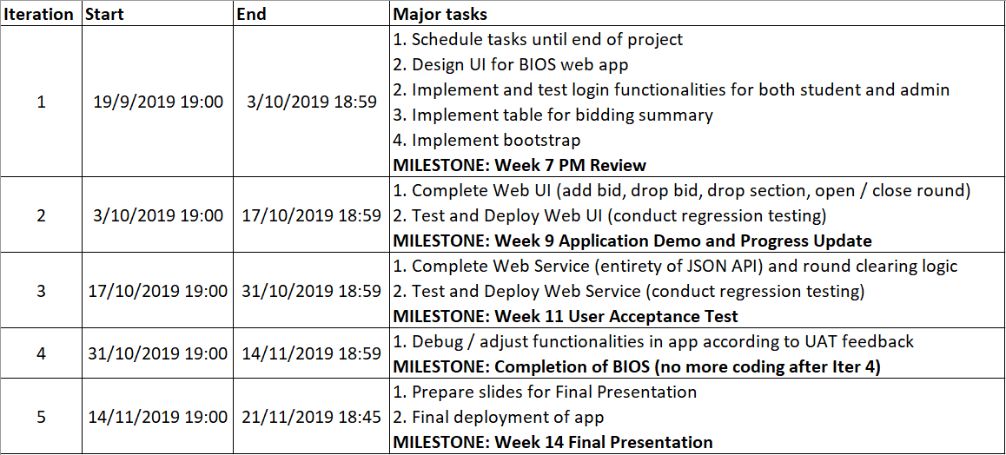
SCHEDULE
Bird’s eye view
Notes:
Schedule
Tell us your schedule. Do not show us the raw schedule on Google Sheets. Summarize it but give us sufficient details to have a bird’s-eye view of your project.
What are your planned iterations and what are the tasks in each iteration?
When is each iteration starting and ending?
Who is doing what?
What are your milestones?
How much buffer time do you have?
Show us your critical path.

Slide 5
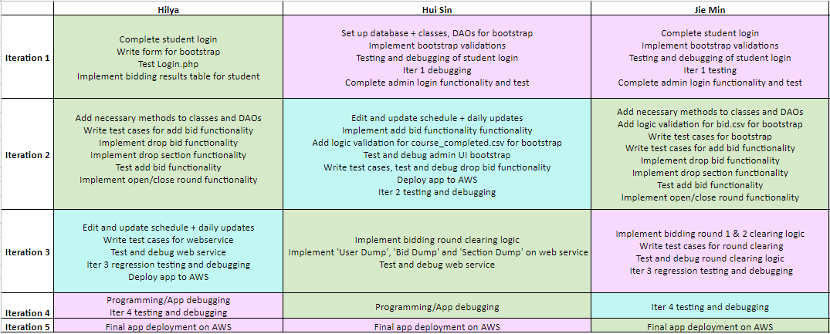

SCHEDULE
Work division

Slide 6
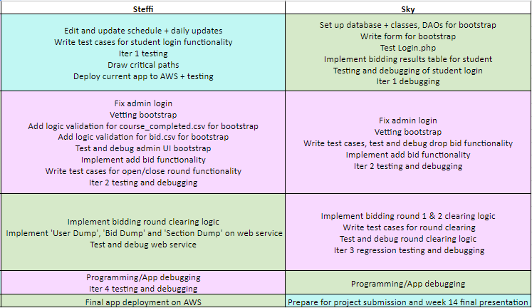
SCHEDULE
Work division

Slide 7
SCHEDULE
How much buffer time do you have?
For every task on the schedule, there is a buffer time of 1-5 days between tasks, unless the tasks are concurrent.

Slide 8
CRITICAL PATH ANALYSIS
Iteration 1 (planned)
CP: 12 days
Buffer: 2 days
1 First meeting and initial planning
3 days
3 Set up database, write code for classes and DAOs
1 day
4 Complete student login
1 day
6 Implement bidding summary and results table for student
1 day
5 Implement bootstrap validations
1 day
7 Team meeting, testing and debugging for login
1 day
Normal task
First / last task
Critical path
10 Week 7 PM Review
1 day
9 Prepare and submit slides, deploy app
3 days
8 Implement and test admin login
1 day
2 Daily updates
14 days

Slide 9
CRITICAL PATH ANALYSIS
Iteration 1 (actual)
CP: 10 days
Buffer: 4 days
1 First meeting and initial planning
3 days
3 Set up database, write code for classes and DAOs
1 day
4 Complete student login
1 day
6 Implement bidding summary and results table for student
1 day
2 Daily updates
14 days
5 Implement bootstrap validations
3 days
7 Team meeting, testing and debugging for login
1 day
10 Week 7 PM Review
1 day
9 Prepare and submit slides, deploy app
1 day
8 Implement and test admin login
1 day

Slide 10
CRITICAL PATH ANALYSIS
Iteration 2 (planned)
CP: 6 days
Buffer: 8 days
4.2 Implement and test ‘drop bid’ functionality
1 day
4.1 Complete ‘bidding results’, implement and test ‘add bid’ functionality
1 day
3 Add necessary methods to classes and DAOs
1 day
4.3 Implement and test ‘drop section’ functionality
1 day
6 Iter2 regression testing and debugging
1 day
7 Prepare and submit slides
1 day
5 Implement and test ‘open/close round’ functionality
1 day
8 Deploy app
1 day
9 Week 9 Application Demo and Progress Update Presentation
1 day
1 Daily updates
14 days
2 Complete and test admin bootstrap
1 day

Slide 11
CRITICAL PATH ANALYSIS
Iteration 2 (actual)
17.4 Test and debug add bid, drop bid, open / close round
3 days
CP: 10 days
Buffer: 4 days
10 Implement add bid and drop bid
2 days
5 Add necessary methods to classes and DAOs
2 days
14 Implement ‘open/close round’
1 day
19 Iter2 regression testing and debugging
1 day
20 Prepare and submit slides
1 day
8 Write test cases for add bid, drop bid, open / close round
2 days
22 Week 9 Application Demo and Progress Update Presentation
1 day
6 Complete bootstrap
3 days
21 Deploy app and test on cloud
1 day
17.1 Test and debug bootstrap
2 days
7 Write test cases for bootstrap
1 day
1 Daily updates
14 days

Slide 12
CRITICAL PATH ANALYSIS
Iteration 3
CP: 9 days
Buffer: 5 days
2 Implement round 1 and round 2 clearing logic
3 days
5 Test and debug round clearing logic
1 day
4.1 Write test cases for round clearing
1 day
7 Iter3 regression testing and debugging
1 day
8 App deployment and testing on cloud
1 day
9 Week 11 User Acceptance Test
1 day
3 Implement web service
4 days
6 Test and debug web service
2 days
1 Daily updates
14 days
4.2 Write test cases for web service
1 day

Slide 13
CRITICAL PATH ANALYSIS
Iteration 4
CP: 8 days
Buffer: 6 days
2 Team meeting and planning (discuss UAT feedback)
1 day
3 Programming / app debugging (Part 1)
2 days
Regression testing
1 day
4 Programming / app debugging (Part 2)
2 days
5 Iter4 testing and debugging
1 day
1 Daily updates
14 days
App deployment and testing on cloud
1 day

Slide 14
CRITICAL PATH ANALYSIS
Iteration 5
CP: 8 days
Buffer: 6 days
3 Check and submit all project files in repository
1 day
4 Final app deployment
2 days
5 Week 14 Final Presentation
1 day
1 Daily updates
3 days
2 Prepare slides for Week 14 submission
2 days

Slide 15
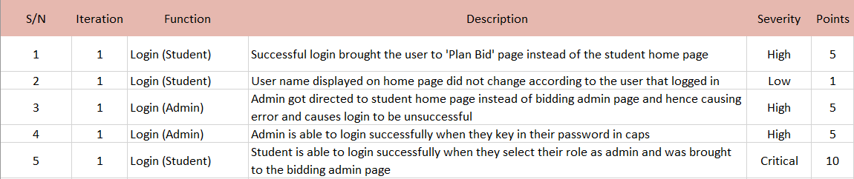
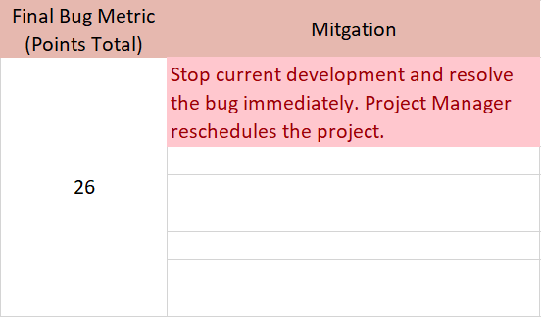
BUG METRICS (Iteration 1)
All bugs were found during the scheduled debugging sessions for each functionality, but for bootstrap the planned debugging session was too short and another had to be arranged with the PM for the next day, to resolve the remaining bugs.
Notes:
Bug Metrics
What is the current value for the metric & did you have to take any action according to your mitigation plan?

Slide 16
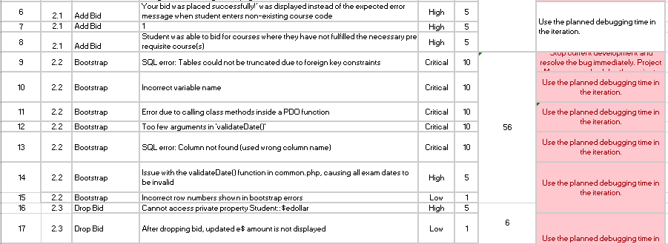
BUG METRICS (Iteration 2)
Notes:
Bug Metrics
What is the current value for the metric & did you have to take any action according to your mitigation plan?

Slide 17
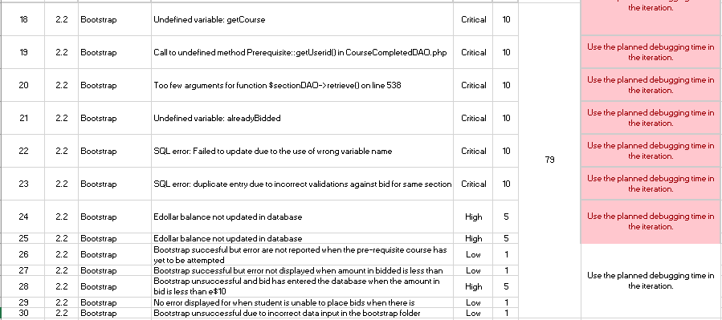
BUG METRICS (Iteration 2)
All bugs were found during the scheduled debugging sessions for each functionality, we have managed to solve them during the scheduled debugging sessions
Notes:
Bug Metrics
What is the current value for the metric & did you have to take any action according to your mitigation plan?

Slide 18
ROLES & RESPONSIBILITIES
Role allocations for each iteration
Iteration 1
PM: Steffi - Milestone: Week 7 PM Review
Coder: Hui Sin, Jie Min, Hilya, Sky
Iteration 2
PM: Hui Sin - Milestone: Week 9 Application Demo and Progress Update
Coder: Steffi, Jie Min, Hilya, Sky
Iteration 3
PM: Hilya - Milestone: Week 11 User Acceptance Test
Coder: Steffi, Hui Sin, Jie Min, Sky
Iteration 4
PM: Jie Min - Milestone: Project Submission
Coder: Steffi, Hui Sin, Hilya, Sky
Iteration 5
PM: Sky - Milestone: Week 14 Final Presentation
Coder: Steffi, Hui Sin, Jie Min, Hilya
Notes:
Roles & responsibilities
Who is doing what (Project Manager, coder, etc.)?
What is the rotation plan? List specifically the PM is in charge of which milestone?

Slide 19

ROLES AND RESPONSIBILITIES
Pair programming and PM rotations
For Iter 2, we did not adhere to the coding pairs strictly, due to scheduling conflicts with members who were busy with work or camps during recess week. We also allowed the PM to code during recess week.
Notes:
What are the pair programming teams and the rotation plan for the teams?

